Slide 1
Lesson 05 Transformations Using Matrices
Interactive Seminar Slides
E114 – Mathematics for Engineering

Slide 2
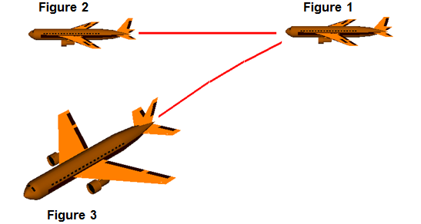
Scenario
Perspective view of the airplane in various positions during flight
(Source: Google Image from NASA, Glenn Resource Center)
Refer to the above image of an airplane travelling in the air. From Figure 1 to Figure 2, how has the airplane changed position? Can you describe the single transformation involved?
Now refer to Figures 1 and 3. From Figure 1 to Figure 3, how has the airplane changed position? Can you identify the sequence of transformations involved? You may assume that the airplane travels on the same horizontal plane during flight.

Slide 3
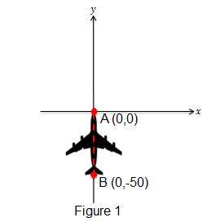
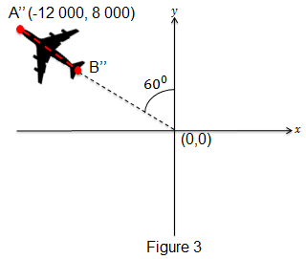
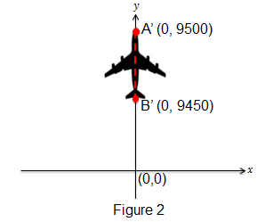
Scenario Tasks
When viewed from the top, the nose and end of the airplane can be represented by points A(0,0) and B(0,-50) in the 𝑥−𝑦 plane where 𝑥 and 𝑦 represent distances in metres (m).
Let A’ and B’ be the coordinates of the image points corresponding to A and B respectively in Figure 2. Describe the transformation involved from Figure 1 to Figure 2.
Let A’’ and B’’ be the coordinates of the image points corresponding to A and B respectively in Figure 3. Identify the sequence of transformations involved, and determine the coordinates of B’’.

Slide 4
Scenario Definition Template
What We Know:
To describe the transformation from Figure 1 to Figure 2
Coordinates of the initial points A and B in Figure 1
Coordinates of the image points A’ and B’ in Figure 2
Coordinates of the image point A’’ in Figure 3
To describe the transformation from Figure 1 to Figure 3
To describe the sequence of transformations from Figure 1 to Figure 3, and to determine the coordinates of B’’ in Figure 3
What We Don’t Know:
What are transformations?
What type of transformations are there?
How do we distinguish between each type of transformation?
How to describe a transformation in words?
How to determine the coordinates of an image point when undergoing transformation(s)?
What We Need to Find Out:
The two types of transformations in this module
How to describe each transformation in words?
Identifying each type of transformation
Applying matrices to determine the coordinates of points undergoing a transformation

Slide 5
Lesson Overview
S/N | Concepts | Slide Number
1 | Introduction to Transformations | 6
2 | Translation
i. | Definition | 7-10
ii. | Order of a Matrix | 11-12
iii. | Matrix Addition and Subtraction | 13-16
iv. | Translation Matrix | 17-21
3 | Rotation
i. | Definition | 23-25
ii. | Matrix Multiplication | 26-32
iii. | Rotation Matrix | 33-38
4 | Combined Transformation (CL) | 39-49

Slide 6
Introduction to Transformations
A transformation of a plane takes any point 𝑃(𝑥,𝑦) on the plane and maps it onto one and only image, 𝑃′(𝑥′,𝑦′) that also lies on the same plane.
We say that “point 𝑃 is mapped onto the image 𝑃′ under the transformation”.
There are several types of transformations, such as translation, rotation, reflection and scaling.
In this problem, only translation and rotation will be covered.

Slide 7
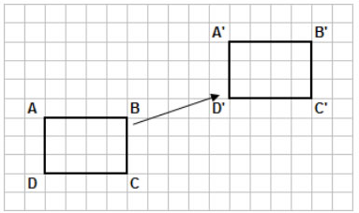
Translation - Definition
Translation is the movement of a planar entity from one location to another, while maintaining its size, shape and orientation.
We describe translations along the x and y axes in the following manner:
“Translation of 𝑎 units along the positive 𝑥 axis direction and 𝑏 units along the positive 𝑦 axis direction”
For translation along 𝑥 axis:
If 𝑎 > 0, translation is towards the right
If 𝑎 < 0, translation is towards the left
For translation along 𝑦 axis:
If 𝑏 > 0, translation is upwards
If 𝑏 < 0, translation is downwards
(Source: Google Image from
http://www.onlinemathlearning.com )

Slide 8
Translation-Definition
[Example 1]
Describe the transformation shown in the following figures.
Before transformation
After transformation
[Solution]
This is a translation of 17 units along the positive 𝑥 axis direction and 17 units along the positive 𝑦 axis direction.

Slide 9
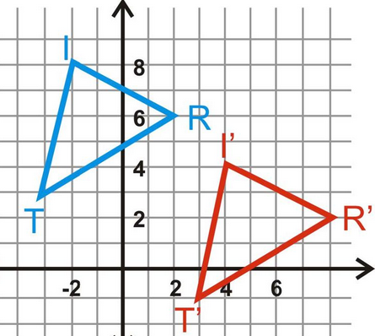
Translation-Definition
[Example 2]
Describe the transformation shown in the following figure, where the points 𝐼, 𝑅 and 𝑇 are mapped onto their corresponding images 𝐼’, 𝑅’ and 𝑇’.
[Solution]
This is a translation of 6 units along the positive 𝑥 axis direction and -4 units along the positive 𝑦 axis direction.
(Source: Google Image from www.suggestkeyword.com)

Slide 10

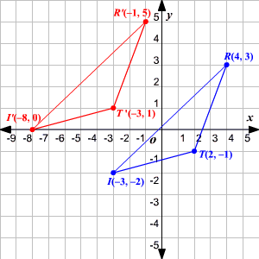
Test Yourself: Translation-Definition
Describe the transformation shown in the following figure, where the points 𝐼, 𝑅 and 𝑇 are mapped onto their corresponding images 𝐼’, 𝑅’ and 𝑇’.
(Source: Google Image from pgdn.dvrlists.com)

Slide 11
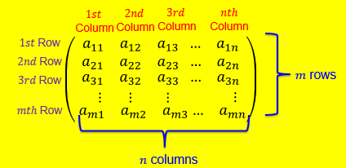
Order of a Matrix
The order of a matrix is given by , where
𝑚 = number of rows
𝑛 = number of columns
i.e.
The entry 𝑎_{𝑖𝑗} of the matrix is a number, which lies at the 𝑖th row and the 𝑗th column.

Slide 12

Test Yourself: Order of a Matrix (Kahoot.IT)
Write down the order for each of the following matrices:
(2)
.
.
.
Notes:
Kahoot link: https://play.kahoot.it/#/k/a12a67ac-8cc3-47b8-836a-4f0804b2b4a3

Slide 13
Translation - Matrix Addition and Subtraction
For matrix addition or subtraction of two matrices A and B, they must be of the same order:
The resulting matrix from the addition or subtraction of A and B also has the same order as A and B
Similar to vector addition or subtraction, matrix addition or subtraction is simply adding or subtracting the corresponding entries in the matrices
[Example 4]

Slide 14
Test Yourself:
Matrix Addition and Subtraction
Perform the following matrix addition/subtraction (if the operation is defined):
i.
ii.
iii.

Slide 15
Test Yourself:
Matrix Addition and Subtraction

Slide 16
Test Yourself:
Matrix Addition and Subtraction

Slide 17
Translation - Translation Matrix
Translation can be represented using a matrix, called the translation matrix.
For translation of 𝑎 units along the positive x axis direction and b units along the positive y axis direction, the translation matrix is .
Let a general point 𝑃(𝑥,𝑦) be mapped onto its image 𝑃′(𝑥′,𝑦′) under a translation with matrix . The matrix
containing the coordinates of P’ is obtained by adding the translation matrix to the matrix containing the coordinates of P :

Slide 18

Translation - Translation Matrix
[Example 5]
A point 𝐴(3,2) undergoes a translation of 10 units to the left and 4 units upwards. Find the coordinates of its image, 𝐴′.
[Solution]
First, write down the matrix containing the coordinates of 𝐴 and the translation matrix:
Matrix containing coordinates of
Translation matrix =
Next, perform matrix addition to find the matrix containing the coordinates of image point 𝐴′ :
Matrix containing the coordinates of
$∴$Coordinates of 𝐴′ are (-7, 6).
Note:
Ensure both matrices have the same order before performing matrix addition!

Slide 19

Translation - Translation Matrix
[Example 6]
A quadrilateral with vertices 𝐴(3,2), 𝐵(-1,4), 𝐶(2,5) and 𝐷(1,-1) undergoes a translation of 2 units to the right and 6 units downwards. Find the coordinates of all their images.
[Solution]:
First, write down the matrix containing the coordinates of all vertices and the translation matrix:
Matrix containing coordinates of vertices =
Translation matrix =
Next, perform matrix addition to find the position vectors of image points:
$∴$Coordinates of the images of 𝐴, 𝐵, 𝐶 and 𝐷 are (5, -4), (1, -2), (4, -1) and (3, -7) respectively.
Note:
Ensure both matrices have the same order before performing matrix addition!

Slide 20
Test Yourself:
Translation -Translation Matrix

Slide 21
BRAIN BREAK
To every action there is always opposed an equal reaction.
-- Sir Isaac Newton

Slide 22
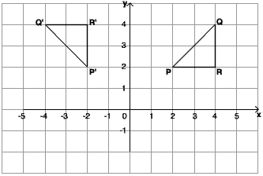
Rotation - Definition
Rotation is the change in orientation of a planar entity about a fixed point (also called the centre of rotation) while maintaining its size and shape.
For this problem, we shall consider only the origin (0,0) to be the centre of rotation.
We describe rotation in the following manner:
“Rotation through an angle of 𝜃^{𝜊}, clockwise (or anti- clockwise) about the origin”.
(Source: Google Image from
http://www.bbc.co.uk/bitesize/quiz/q17943937 )

Slide 23
Rotation - Definition
[Example 7]
Describe the transformation shown in the following figures.
(0 , 0)
(8 , 0)
(11 , 0)
(8 , -5)
Before transformation
After transformation
[Solution]
This is a rotation through an angle of 90^{𝜊}, clockwise about the origin.
Or This is a rotation through an angle of 270^{𝜊}, anti-clockwise about the origin.

Slide 24
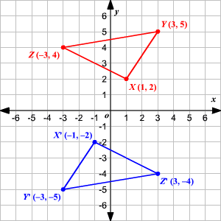
Test Yourself:
Rotation - Definition
Describe the transformation shown in the following figure, where the points 𝑋, 𝑌 and 𝑍 are mapped onto their corresponding images 𝑋′, 𝑌′ and 𝑍′.
(Source: Google Image from
http://hotmath.com/hotmath_help/topics/transformation-of-graphs-using-matrices-rotations.html )

Slide 25
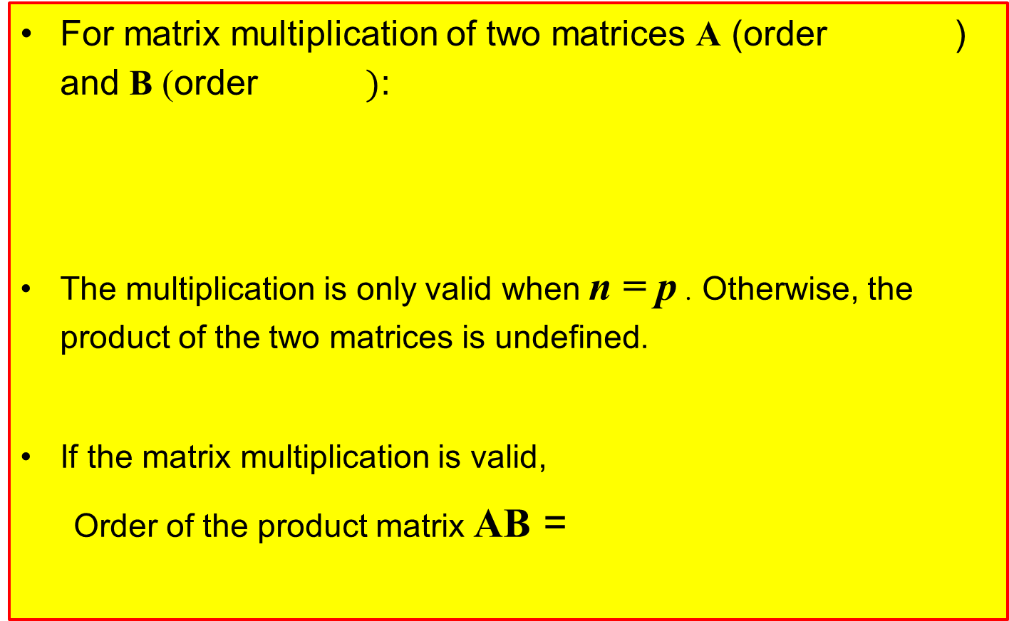
Matrix Multiplication
For matrix multiplication of two matrices A (order ) and B (order $)$:
The multiplication is only valid when n = p . Otherwise, the product of the two matrices is undefined.
If the matrix multiplication is valid,
Order of the product matrix AB =

Slide 26


Matrix Multiplication
[Example 6]
Find the product 𝐀𝐁, where 𝐀 and 𝐁
[Solution]
First, note that the product AB is defined because A has order 3 x 2 while B has order 2 x 2. Hence, the product 𝐀𝐁 has order 3 x 2 and will take the form:
𝐀𝐁 =
Where 𝑐_{𝑖𝑗} = entry of the product matrix in the ith row and jth column
= sum of {entries in 𝑖th row of 𝐀 x corresponding entries in jth column of 𝐁}
Next, calculate each entry of the product matrix:
𝑐₁₁
= entry in 1st row and 1st column
= sum of {entries in 1st row of 𝐀 x corresponding
entries in 1st column of 𝐁}
= (−1)(−3)+(3)(−4) =−9
1st Row of $A$
1st Column of $B$

Slide 27
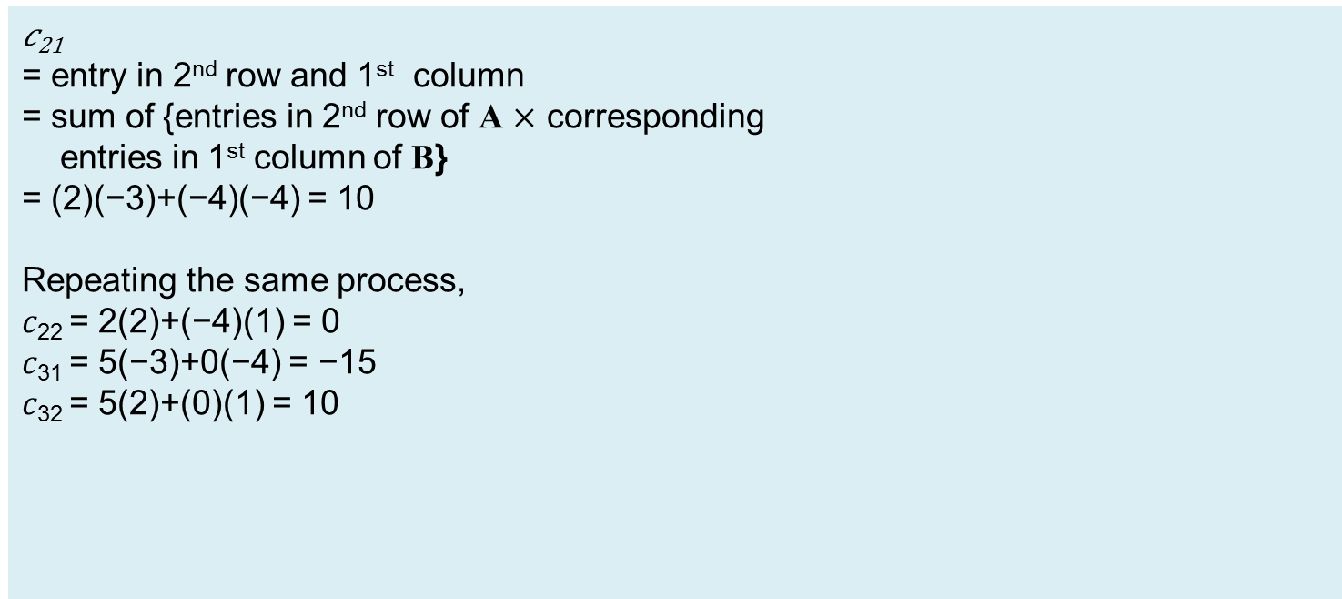
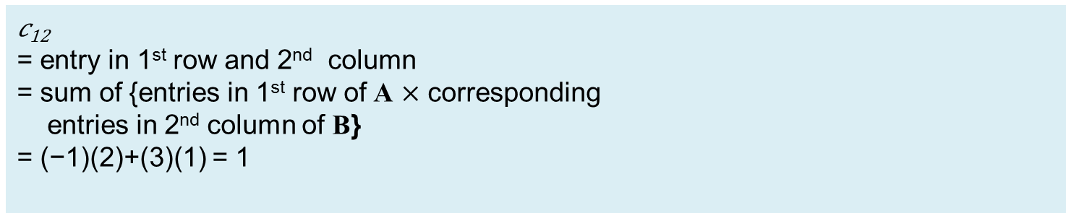
Matrix Multiplication
𝑐₁₂
= entry in 1st row and 2nd column
= sum of {entries in 1st row of A $×$ corresponding
entries in 2nd column of B}
= (−1)(2)+(3)(1) = 1
1st Row of A
2nd Column of B
𝑐₂₁
= entry in 2nd row and 1st column
= sum of {entries in 2nd row of A $×$ corresponding
entries in 1st column of B}
= (2)(−3)+(−4)(−4) = 10
Repeating the same process,
𝑐₂₂ = 2(2)+(−4)(1) = 0
𝑐₃₁ = 5(−3)+0(−4) = −15
𝑐₃₂ = 5(2)+(0)(1) = 10
2nd Row of A
1st Column of B

Slide 28
Matrix Multiplication
[Example 7]
Given that A = and B = , evaluate AB and BA.
[Solution]
AB is defined and has order 2 x 1.
AB =
=
The product matrix BA is undefined.

Slide 29
Test yourself: Matrix Multiplication
Suppose Matrix A is and Matrix B is .
Evaluate the product matrix AB.
Evaluate the product matrix BA.

Slide 30
Test yourself: Matrix Multiplication

Slide 31
Matrix Multiplication
Matrix multiplication is not commutative. i.e., the sequence of the matrices in the matrix multiplication will affect the result, even if the two matrices are square matrices of the same order n.
.
[Example 8]
Suppose Matrix A is and Matrix B is .
The matrix multiplication AB gives:
The matrix multiplication BA gives:
In general, AB ≠ BA.

Slide 32
Rotation - Rotation Matrix
A rotation can be represented by a matrix, known as a rotation matrix.
For anticlockwise rotation about the origin:
Rotation matrix =
For clockwise rotation about the origin:
Rotation matrix =
After rotation
θ
Before rotation
Anti-clockwise rotation about the origin
Before rotation
θ
After rotation
Let a general point 𝑃(𝑥,𝑦) be mapped onto its image 𝑃′(𝑥′,𝑦′) under a rotation about the origin. The matrix containing the coordinates of 𝑃′ is obtained by pre-multiplying the rotation matrix to the matrix containing the coordinates of 𝑷 :
= Rotation matrix
Clockwise rotation about the origin

Slide 33
Rotation - Rotation Matrix
[Example 10]
A point A(3,2) undergoes a rotation of 30∘, anti-clockwise about the origin. Determine the coordinates of its image, A’.
[Solution]
First, determine the rotation matrix and write down the matrix containing the coordinates of A:
Rotation matrix
Matrix containing coordinates of A =
Next, perform matrix multiplication to determine the coordinates of image point:
Coordinates of A’ are (1.60, 3.23).

Slide 34
Rotation - Rotation Matrix
[Example 11]
The flag in the figure undergoes a clockwise rotation of 90º about the origin. Find the coordinates of all points on the flag after the rotation.
[Solution]
First, determine the rotation matrix and write down the matrix containing the coordinates of all the points:
Rotation matrix
Matrix containing coordinates of initial points
Before rotation

Slide 35
Rotation - Rotation Matrix
[Solution]
Next, apply matrix multiplication to determine the matrix containing the coordinates of all the image points:
Coordinates of the points after rotation are (0,0), (8,0), (11,0) and (8, -5).
(0 , 0)
(8 , 0)
(11 , 0)
(8 , -5)
Note
After the matrix multiplication has been carried out, we see that the new coordinates indeed correspond to a clockwise rotation of 90º about the origin.
After rotation

Slide 36
Test Yourself:
Rotation - Rotation Matrix
Refer to the figure on the right.
It has several reference points, one of which is A(5,8).
The figure undergoes an anti-clockwise rotation of 15^{𝑜} about the origin.
Determine the coordinates of the image point of 𝐴.

Slide 37
Test Yourself:
Rotation - Rotation Matrix

Slide 38
Combined Transformation (CL)
A combined transformation comprises 2 or more single transformations conducted in sequence.
E.g. Consider the following sequence of transformations:
Rotation through an angle of 𝜃^{𝜊}, clockwise about the origin, followed by
Translation of 𝑚 units along the positive x axis direction and 𝑛 units along the positive y axis direction.
Let 𝑃(𝑥,𝑦) be the initial point, 𝑃′(𝑥′,𝑦′) its image under Transformation 1 (rotation), and 𝑃′′(𝑥′′,𝑦′′ ) the image of 𝑃′ under Transformation 2 (translation).
The matrix containing the coordinates of P” can be found as follows:
(x’’, y’’)
θ
n units
(x’, y’)
m units

Slide 39
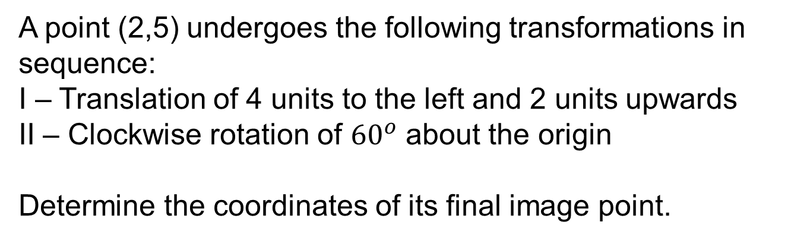
Combined Transformation (CL)
[Example 12]
A point (2,5) undergoes the following transformations in sequence:
I – Translation of 4 units to the left and 2 units upwards
II – Clockwise rotation of ${60}^{o}$ about the origin
Determine the coordinates of its final image point.

Slide 40
Combined Transformation (CL)
[Solution]
It is important to follow the transformations in the exact sequence given, so let’s perform the translation first.
Translation Matrix =
Hence, the image point of (2,5) immediately after the translation has coordinates (-2,7).

Slide 41
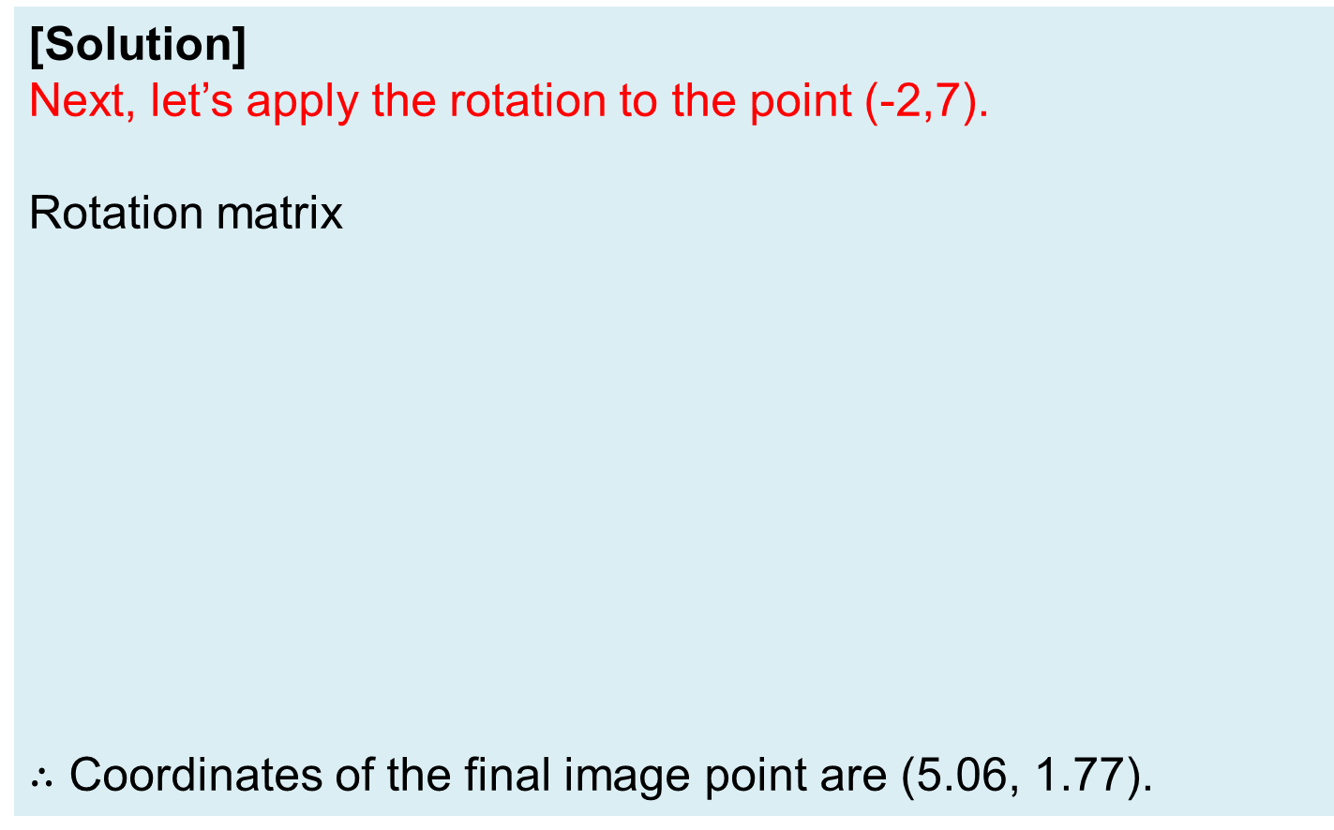
Combined Transformation (CL)
[Solution]
Next, let’s apply the rotation to the point (-2,7).
Rotation matrix
$∴$ Coordinates of the final image point are (5.06, 1.77).

Slide 42
Test Yourself: Combined Transformation (CL)
Refer back to the earlier example.
We still have the same initial point (2,5), but this time round, the sequence of the transformations is reversed, and we have the new sequence as follows:
I –Clockwise rotation of 60º about the origin
II –Translation of 4 units to the left and 2 units upwards
Determine the coordinates of its final image point.

Slide 43
Test Yourself: Combined Transformation (CL)

Slide 44
Test Yourself: Combined Transformation (CL)

Slide 45
Combined Transformation (CL)
[Example 13]
A flag has been rotated 300º clockwise about the origin, followed by a translation of 6 units along the positive x axis direction and -8 units along the positive y axis direction.
The coordinates of the image after the combined transformation are
Calculate the coordinates of all points on the flag before the combined transformation.

Slide 46
Combined Transformation (CL)
[Solution]
Rotation through 300⁰, anti-clockwise about the origin
Translation of - 6 units along positive x axis direction and 8 units along positive y axis direction
Matrix Containing
Initial Coordinates (?)
?
Rotation through 300⁰ clockwise about the origin
Translation of 6 units along positive x axis direction and -8 units along positive y axis direction
To find the initial coordinates, we conduct the transformations in the reverse order.

Slide 47
Combined Transformation (CL)
[Solution]
Obtain the coordinates of the image of the flag after translation of - 6 units along positive x axis direction and 8 units along positive y axis direction:
Correct?

Slide 48
Combined Transformation (CL)
[Solution]
Obtain the coordinates of the image of the flag after rotation through 300º, anti-clockwise about the origin
The coordinates of the initial points are (0,0), (0,8), (0,11) and (5,8).

Slide 49
One-minute write
Instruction for lecturers: please copy the correct link and put it in the yellow box in the next slide for your IS class:
https://todaysmeet.com/LRE2-Day3
https://todaysmeet.com/LRE4-Day3
https://todaysmeet.com/LRW3-Day3
https://todaysmeet.com/LRW5-Day3
https://todaysmeet.com/LRE5-Day3
https://todaysmeet.com/LRE2-Day4
https://todaysmeet.com/LRE4-Day4
https://todaysmeet.com/LRW3-Day4
https://todaysmeet.com/LRW5-Day4
https://todaysmeet.com/LRE5-Day4
https://todaysmeet.com/LRE2-Day1
https://todaysmeet.com/LRE4-Day1
https://todaysmeet.com/LRW3-Day1
https://todaysmeet.com/LRW5-Day1
https://todaysmeet.com/LRE2-Day2
https://todaysmeet.com/LRE4-Day2
https://todaysmeet.com/LRW5-Day2
https://todaysmeet.com/LRW3-Day2

Slide 50
One-minute write
Instruction for lecturers: please copy the correct link and put it in the yellow box in the next slide for your IS class:
https://todaysmeet.com/LRE2-Day5
https://todaysmeet.com/LRE4-Day5
https://todaysmeet.com/LRW3-Day5
https://todaysmeet.com/LRW5-Day5

Slide 51
One-minute write
Please stop what you are doing and produce a written response to either of the following in only one minute:
Identify what is the key learning concepts from the seminar, or
Write down a question with respect to the concepts learnt so far.
Link:

Slide 52
Key Learning Objectives
Model real-world (2-Dimensional geometric transformation) applications using matrices.
Perform basic algebraic operations on matrices.
Represent transformations (translation and rotation) in matrix form.
Apply geometric transformations using translation matrices.
Apply geometric transformations using rotation matrices.

Slide 53
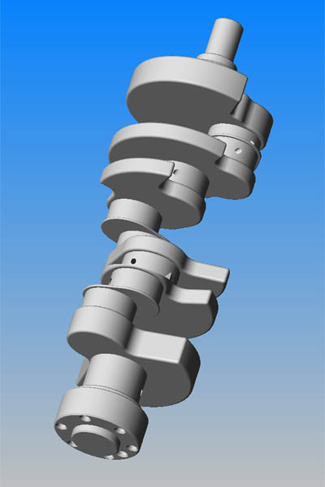
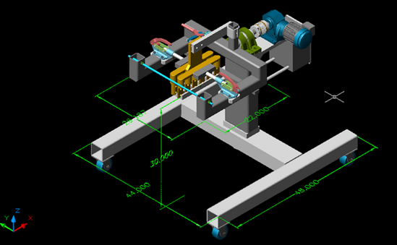
Real-life Applications of Translation and Rotation
Other than being able to translate and rotate the various buildings in the facebook application “Japan Life”, other applications include
Translation and rotation of 3D engineering drawings such that the designer is able to view a design from various angles

Slide 54

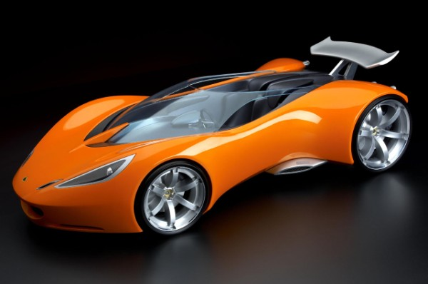
Real-life Applications of Translation and Rotation
Translation and rotation of images in software editing programmes. This is the image of a sports car where every pixel in the image has been rotated by 30 degrees anticlockwise.

